Slide 1



Data Cleaning and Analysis April 2026
Architecting Platforms.
Delivering Trusted Insight.
Enabling Intelligence.
Decision Intelligence, Reporting & Data Platforms
1

Slide 2


Contents
1
Introduction
3
2
Linux
4
Python
3
5
4
Excel
6
5
Dashboard
7
6
Insights
8
DECISION INTELLIGENCE, REPORTING & DATA PLATFORMS

Slide 3
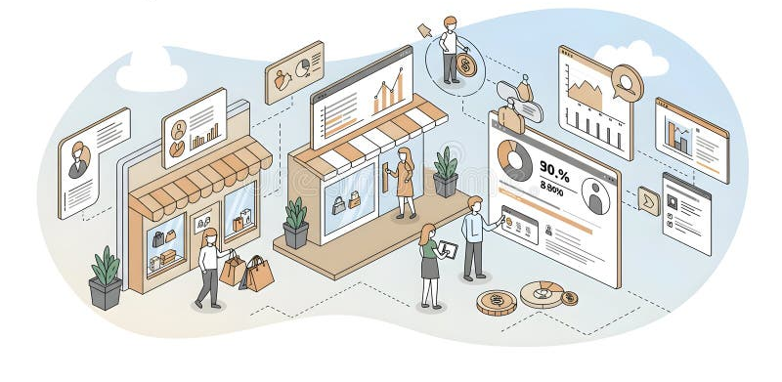
Introduction
It is important for any data analyst to analyse clean and consistent data. The failure to work with cleaned data can lead to heavily obscured insights and inaccurate analysis. In this project we were tasked with setting up a simple workflow to analyse and clean data with a python script within a Linux environment. With successful completion of the workflow, we can now use the cleaned data to set up aesthetic dashboards and informative pivot tables. We can now use these tools to look deeper into the performance of this retail company.
Concepts I will cover:
Linux environment
Python cleaning
Excel pivot tables
Excel dashboard

Slide 4

Linux
Linux is a free, open-source operating system that we accessed using a shell terminal. Building a workflow with Linux to sort and clean data may seem daunting at first but in the long run it will save you time as the need to keep constantly writing a command for every repetitive function disappears and the workflow will run from the shell script consisting of multiple commands.
Use of Linux in This Project
To create and navigate through the project directory and files
To run my python script
To log the steps and execution to a log file

Slide 5
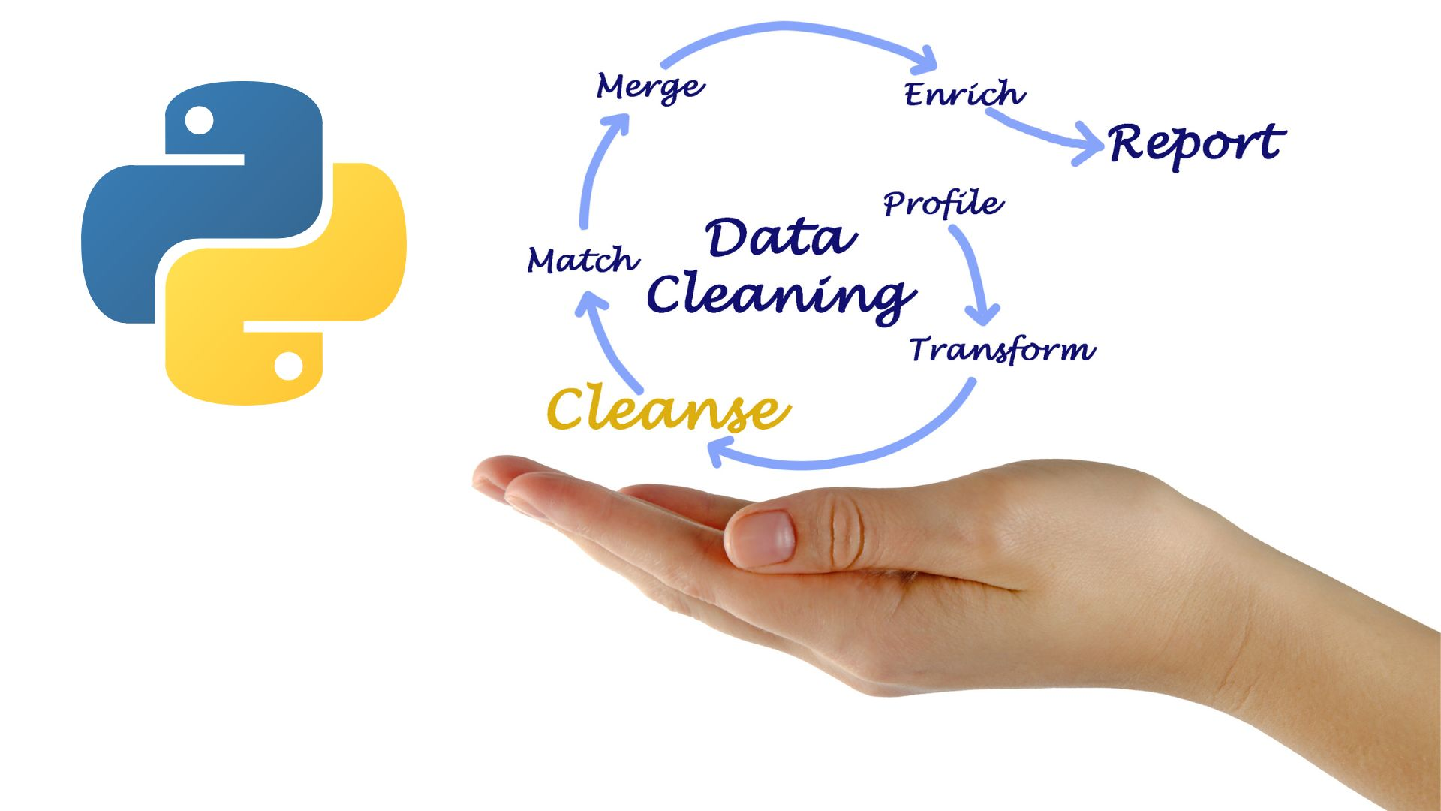
Python
Python is a software development language that allowed me to programmatically view, analyse and clean the messy dataset. I achieved this by primarily making use of python built-in pandas library, which enables powerful data cleaning tools. After cleaning of the data, the script creates a copy of the clean data set and saves it to the output folder within the directory along with additional aggregated data sets.
Use of Python in This Project
To ingest uncleaned data
To perform cleaning operations on the data and saves it to a new file
To create aggregated datasets based on clean data and saves it to new files

Slide 6
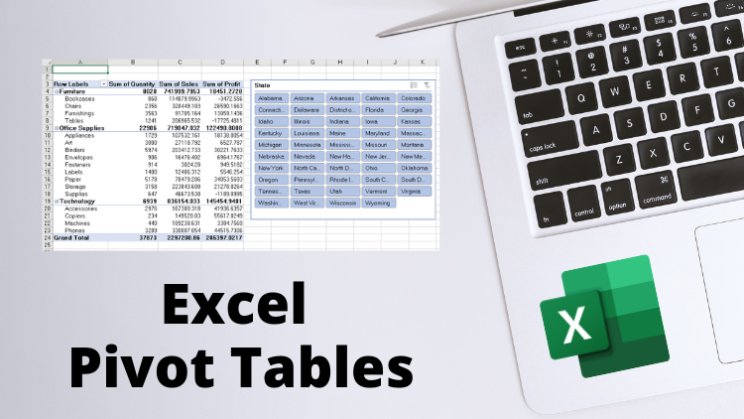
Excel Pivot Tables
With the cleaned data, we can manually import it to a excel spreadsheet and convert it from csv to xlsx with commas as the delimiter. Now we have access to one of excels most powerful data analytics tool – pivot tables. Pivot tables allow us to extract, analyze and summarize the cleaned data. We can further aggregate data to get a peek into insights and trends for deeper levels of analysis that could be beneficial to the company whose data we are working with.
Use of Excel Pivot Tables in This Project
To store our cleaned dataset
To extract specific fields of data for analysis
To scale with the dataset if new data is ever to be introduced

Slide 7
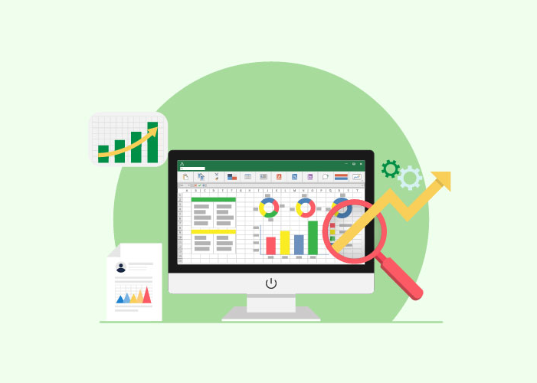
Dashboard
With the pivot table tools, we can also add pivot charts that can be used to visually represent our data. We can arrange and format our charts to create a dashboard with a balance of aesthetics and functionality to gauge trends and insights into our data that we can use for reports and informed decision making. These charts are made from the pivot tables which allow them to be similarly powerful and scalable
Use of a Dashboard in This Project
To allow for data visualization
To create a centralized area for data analysts to gain insights
To allow quicker and efficient access to data insights

Slide 8
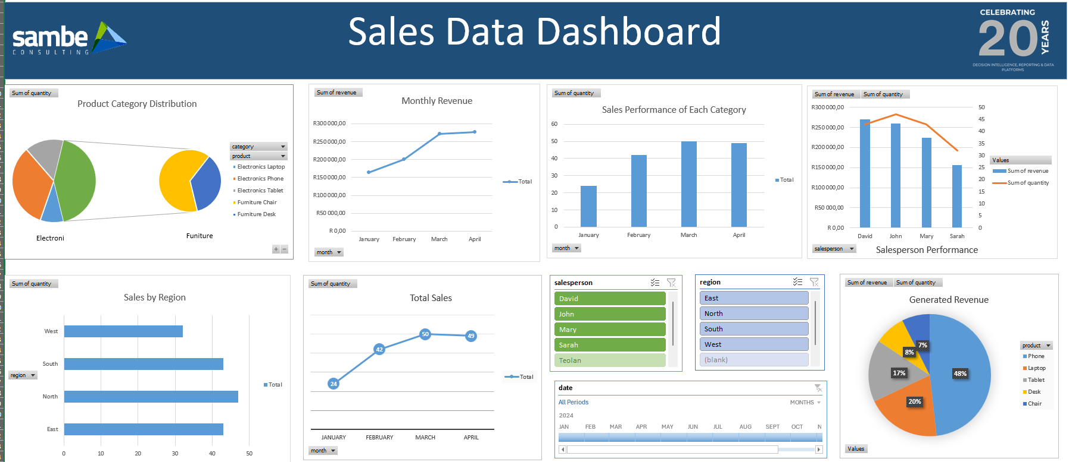
Dashboard

Slide 9
Insights
This chart shows us the total amount of products of each item was purchased within the entire timespan of the dataset. From this we can deduce that Phones and chairs where the most sold items.

Slide 10

Thank You
Teolan Govender
info@sambe.co.za
www.sambe.co.za
1 Maxwell Drive, Woodmead, Sandton, 2191
Decision Intelligence, Reporting & Data Platforms
10
10

